Slide 1

Employee
Salary Prediction
Advaith Achanta

Slide 2
Introduction
OBJECTIVE
LITERATURE REVIEW
DATA COLLECTION
ALGORITHMS
METHODOLOGY
CONCLUSION
Companies keep hiring employees and it has become a necessity to have a system that can accurately estimate the salary that an employee is worthy or receiving in a way that balances employee satisfaction and company expenditure.

Slide 3

OBJECTIVE
LITERATURE REVIEW
DATA COLLECTION
ALGORITHMS
METHODOLOGY
CONCLUSION
Objective
Predicting the salary allocated to an employee by training machine learning models, and performing comparative analysis on linear regression and various other algorithms to provide a user-friendly, simple and accurate prediction tool.

Slide 4
LITERATURE REVIEW
DATA COLLECTION
ALGORITHMS
METHODOLOGY
CONCLUSION
Literature Review
Kumar, A., & Kumar, R. (2021). Prediction of Employee Salaries using Machine Learning Techniques. International Journal of Advanced Science and Technology, 30(4), 3914-3922.
Adhikari, A., & Shrestha, P. (2020). Employee Salary Prediction Using Machine Learning Techniques. International Journal of Scientific Research in Computer Science, Engineering and Information Technology, 6(1), 52-57.
Kaur, S., & Singh, G. (2018). Employee Salary Prediction using Regression Analysis. International Journal of Computer Applications, 181(29), 38-43.

Slide 5
LITERATURE REVIEW
DATA COLLECTION
ALGORITHMS
METHODOLOGY
CONCLUSION
Literature Review
Singh, P., & Kaur, R. (2020). Employee Salary Prediction using Data Mining Techniques. International Journal of Innovative Technology and Exploring Engineering, 9(6), 94-98.
Sharma, M., & Kumar, M. (2019). A Comparative Study of Machine Learning Algorithms for Employee Salary Prediction. Journal of Physics: Conference Series, 1393(1), 012022.

Slide 6
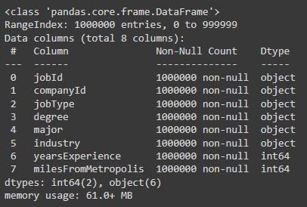
DATA COLLECTION
ALGORITHMS
METHODOLOGY
CONCLUSION
Data Collection
The dataset was extracted from Kaggle
10,00,000 records
Total of 8 columns
‘yearsExperience’ and ‘milesFromMetropolis’ are numerical.
No null values existed

Slide 7
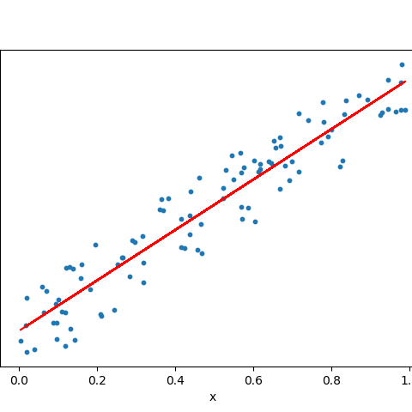
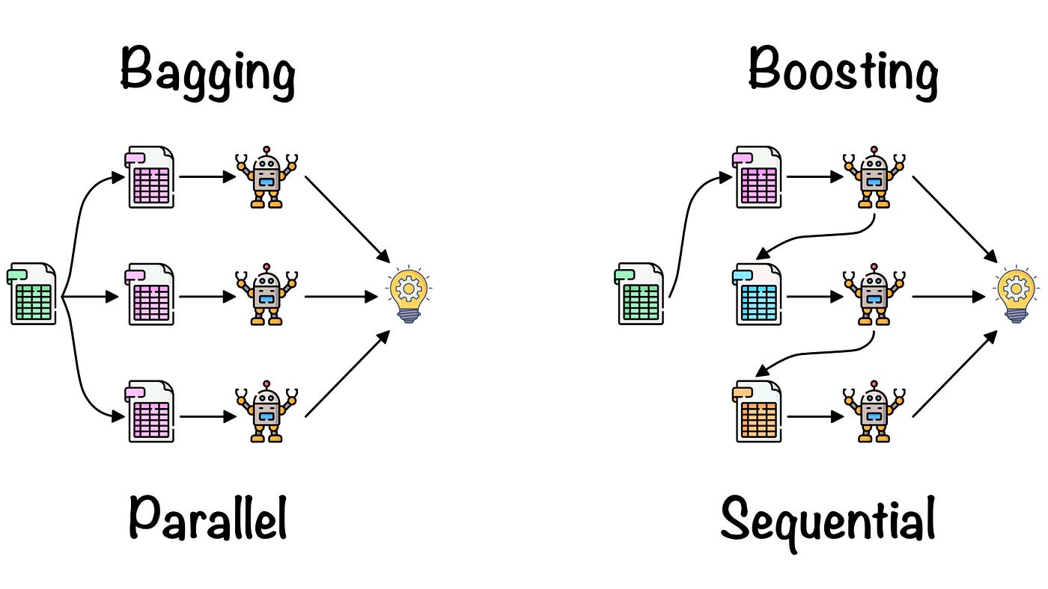
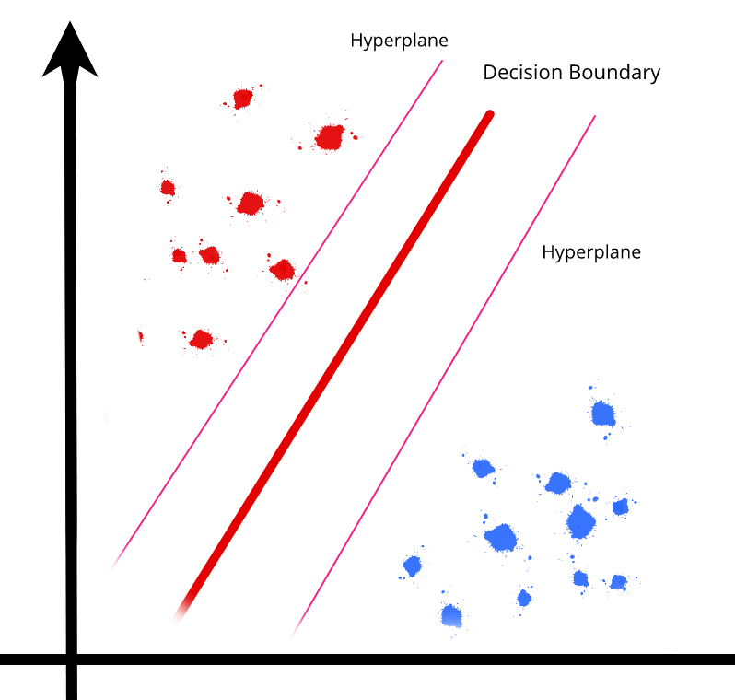

ALGORITHMS
METHODOLOGY
CONCLUSION
DATA COLLECTION
Data Collection
10,00,000 records
Total of 8 columns
‘yearsExperience’ and ‘milesFromMetropolis’ are numerical.
No null values existed
Bagging
Combines multiple models trained on randomly sampled subsets of the training data.
R-Squared – 0.69 RMSE – 21.00 MAE – 16.72

Slide 8
ALGORITHMS
METHODOLOGY
CONCLUSION
DATA COLLECTION
Data Collection
10,00,000 records
Total of 8 columns
‘yearsExperience’ and ‘milesFromMetropolis’ are numerical.
No null values existed
Boosting
A technique that sequentially trains and combines weak prediction models to create a stronger, more accurate model.
Gradient Boosting
R-Squared – 0.75
RMSE – 19.02 MAE – 15.42
XG Boosting
R-Squared – 0.76
RMSE – 18.60 MAE – 15.15

Slide 9
ALGORITHMS
METHODOLOGY
CONCLUSION
DATA COLLECTION
Data Collection
10,00,000 records
Total of 8 columns
‘yearsExperience’ and ‘milesFromMetropolis’ are numerical.
No null values existed
Linear Regression
Models a linear relationship between a dependent and one or more independent variables.
R-Squared – 0.74 RMSE – 19.23 MAE – 15.61

Slide 10
ALGORITHMS
METHODOLOGY
CONCLUSION
DATA COLLECTION
Data Collection
10,00,000 records
Total of 8 columns
‘yearsExperience’ and ‘milesFromMetropolis’ are numerical.
No null values existed
Random Forest
Constructs multiple decision trees and combines their outputs to improve accuracy and reduce overfitting.
R-Squared – 0.71 RMSE – 20.28 MAE – 16.25

Slide 11
ALGORITHMS
METHODOLOGY
CONCLUSION
SVM
A supervised learning algorithm that works by finding the optimal hyper-plane that separates the data into different classes.
R-Squared – 0.76 RMSE – 18.62 MAE – 15.16

Slide 12
METHODOLOGY
CONCLUSION
Combining Independent columns and Dependant column
Unnecessary Strings Removal
Outliers Detection & Removal
Data
Cleaning

Slide 13
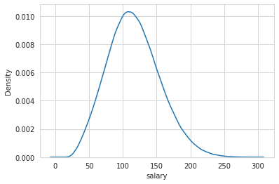
METHODOLOGY
CONCLUSION
Bar Plots
Pie Charts
Heat Map
Top 10’s
EDA

Slide 14
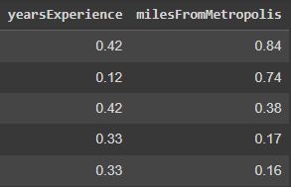

METHODOLOGY
CONCLUSION
Scaling: Scaling data is the process of transforming numerical data to a specific range or distribution, typically between 0 and 1
Encoding: Process of converting categorical data into a numerical format that can be used as input for machine learning models.
Data Pre-Processing

Slide 15
METHODOLOGY
CONCLUSION
The processed data is passed through various machine learning models as mentioned before to obtain metrics and predictions.
The algorithms were iterated with different combinations of train test split ratios, and the 80:20 train test split was chosen to be the best.
Data Modelling

Slide 16
METHODOLOGY
CONCLUSION
The best model was selected, which in this case is the XG Boosting Regressor, and the salary was predicted for the testing set.
The UI was created such that the user can input the jobType, major, degree, industry, yearsExperience, and milesFromMetropolis in order to get an estimation of the salary.
Prediction & UI

Slide 17
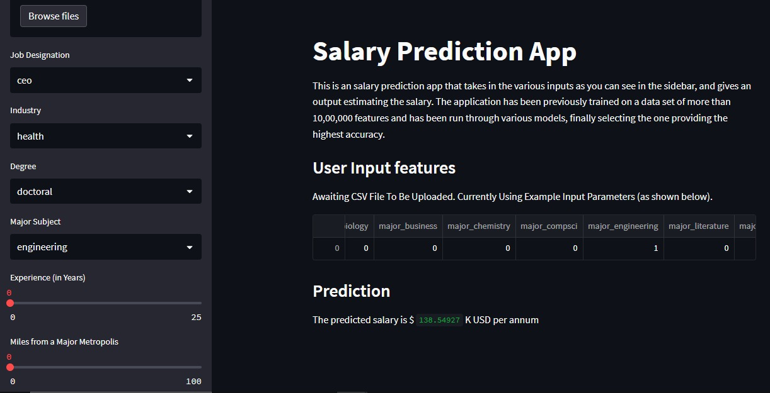
METHODOLOGY
CONCLUSION

Slide 18
CONCLUSION
Conclusion
With the Employee Salary Prediction project, a model has been created which can accurately predict the salaries with the help of input features.
A UI based website has also been created such that the users can easily input their features and get an estimated salary.
The highest paid majors are engineering followed by business.
The highest paying industry is the oil industry, closely followed by the finance industry.
The highest paying job is of a CFO with 301k USD per annum.

